Slide 1

Week #2
AI Academy®
1
Day 1:
Introduction to Daraz
Daraz Seller Benefits
Seller Account Creation
Verification and Documents Required
Guidance and support for Account verifications

Slide 2
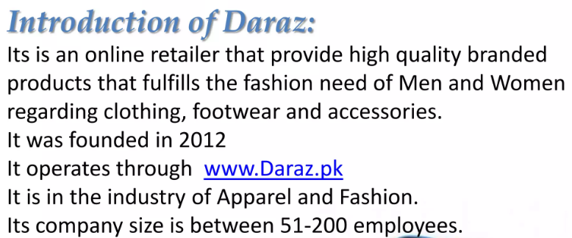
Week #2
AI Academy®
2

Slide 3
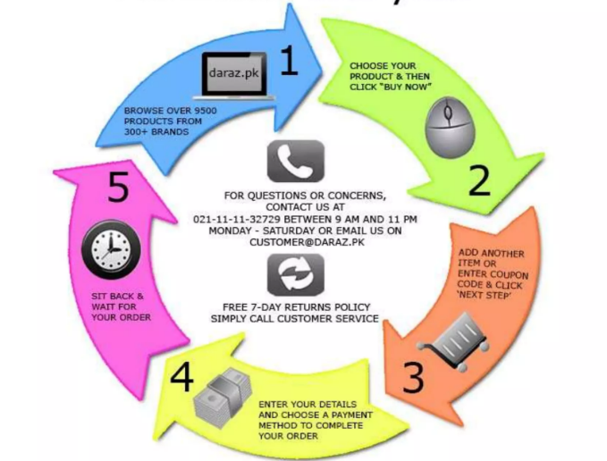
Week #2
AI Academy®
3

Slide 4
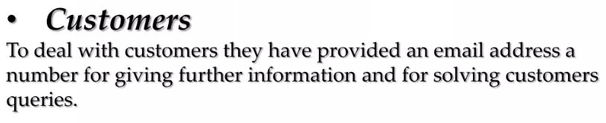
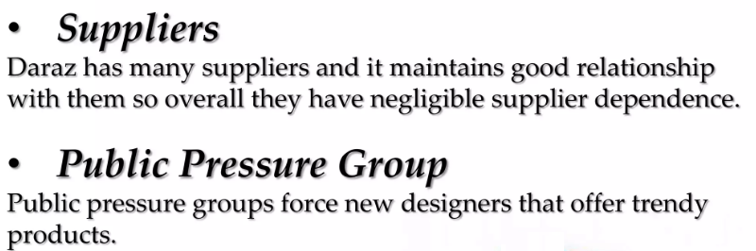
Week #2
AI Academy®
4

Slide 5

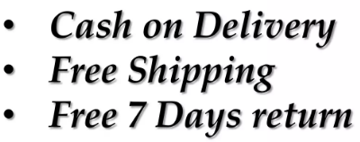


Week #2
AI Academy®
5

Slide 6
Week #2
AI Academy®
6
Day 2:
Introduction to Seller Dashboard
Various Sections and Tools
Order Management
Create Mock Orders
Reviews & Feedbacks

Slide 7
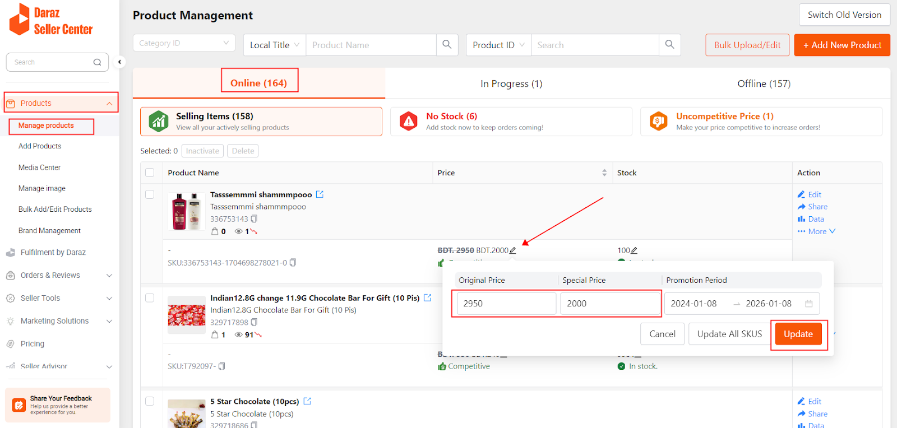
Week #2
AI Academy®
7

Slide 8
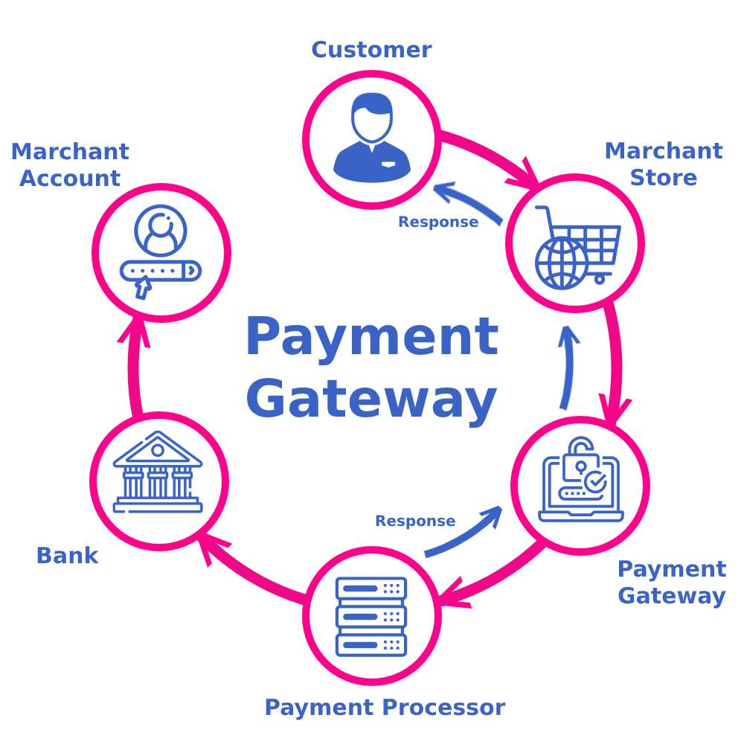
Week #2
AI Academy®
Importance of Payment Gateway:
8
Payment gateways offer many benefits, including improved customer experience, increased operational efficiency, bolstered security measures, and even scaling and global expansion.

Slide 9










Week #2
AI Academy®
eCommerce Best tools:
9
Shopify | MDCart
WooCommerce | eBay
BigCommerce | Amazon
WIX | AliExpress
SquareSpace | Daraz
Platform signs:

Slide 10
Week #1
AI Academy®
10
Day 3:
Product listing guidelines
Listing requires
Title, Description, Images
Creating Sample Product
Review and Feedback on listing

Slide 11
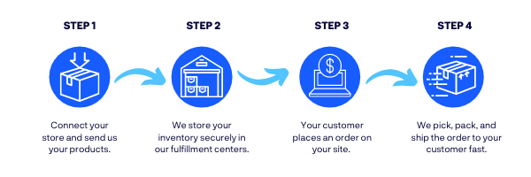
Week #1
AI Academy®
Shipment and Courier:
11

Slide 12
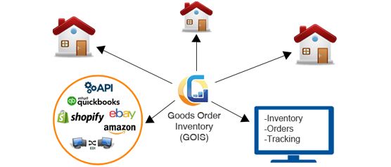
Week #1
AI Academy®
eCommerce Inventory:
12

Slide 13
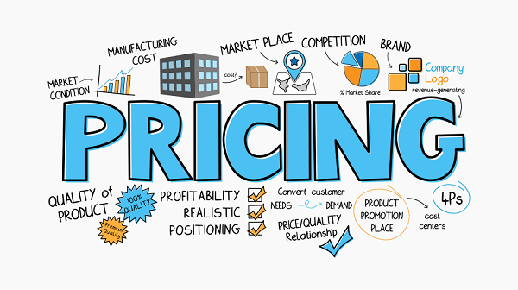
Week #1
AI Academy®
eCommerce Pricing:
13

Slide 14
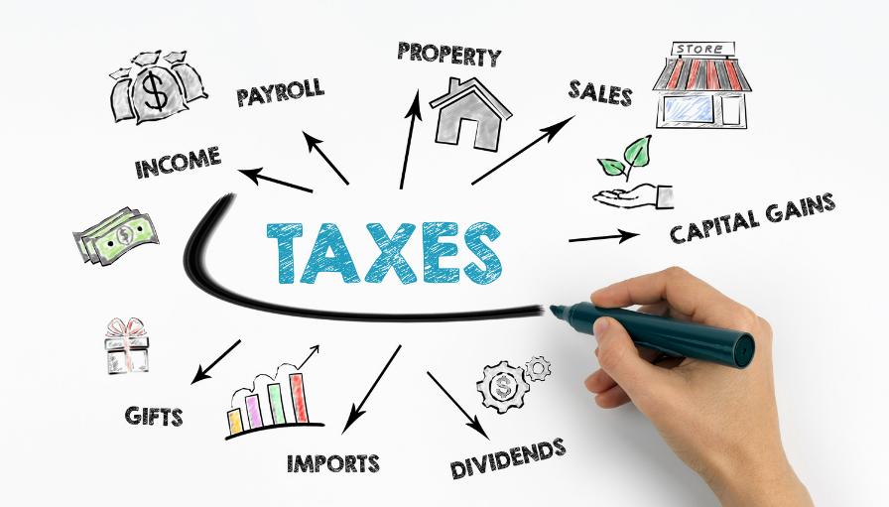
Week #1
AI Academy®
eCommerce Tax management:
14

Slide 15
Week #1
AI Academy®
15
Day 4:
Explore Seller Store front Daraz
Guidelines, personalizing
Banners, logos and Brand identity
Troubleshooting and assistance

Slide 16
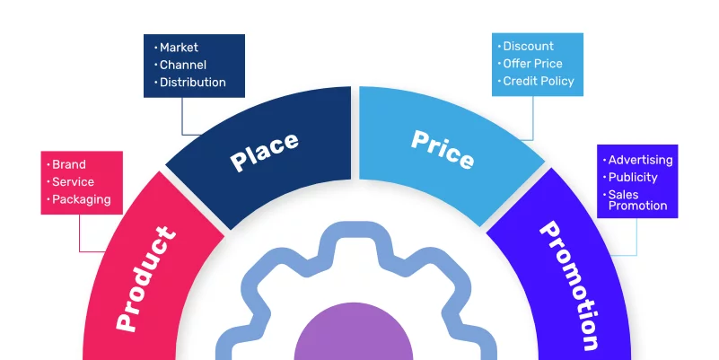
Week #1
AI Academy®
eCommerce 4P’s:
16

Slide 17
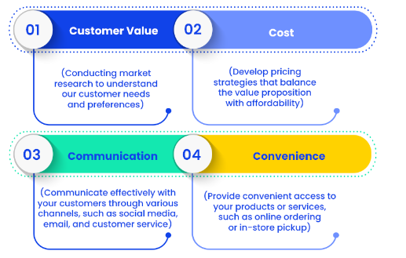
Week #1
AI Academy®
eCommerce 4C’s:
17

Slide 18

Week #1
AI Academy®
eCommerce SWOT Analysis:
18

Slide 19
Week #1
AI Academy®
19
Day 5:
Overview Marking tools for Seller Daraz
Explanation
Promotions, discounts and Sponsoring
Inquiries and managing Orders
Review Inquiries and discussion

Slide 20
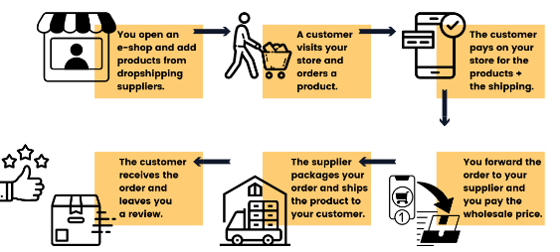
Week #1
AI Academy®
eCommerce Drop-Shipping Model:
20

Slide 21
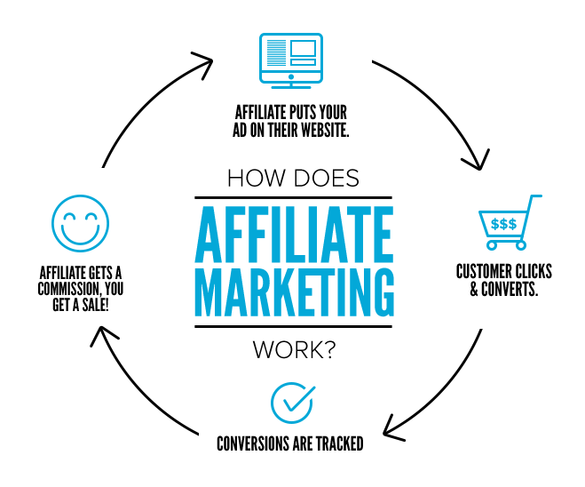
Week #1
AI Academy®
eCommerce Affiliate Model:
21

Slide 22

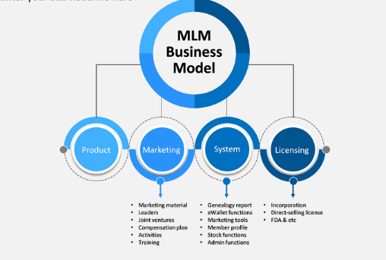
Week #1
AI Academy®
eCommerce MLM Model:
22

Slide 23
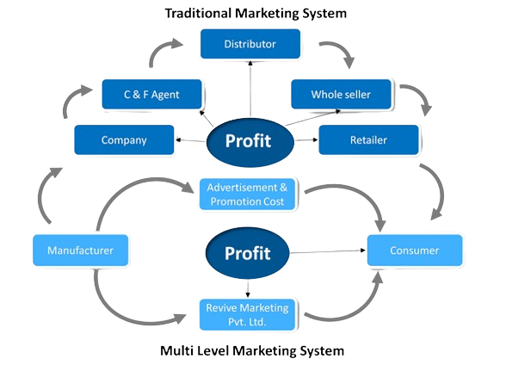
Week #1
AI Academy®
eCommerce MLM Model:
23

